Slide 1
Population pharmacokinetic and exposure-response modeling of patritumab deruxtecan (HER3-DXd)
Tim Waterhouse
March 20, 2025

Slide 2
Acknowledgments
Daiichi Sankyo, Inc.
Li Li
Yuan Xu
Rujuta Joshi
Mark Lee
Yang Chen
Shufang Liu
Toan Ngyuen
Metrum Research Group
Shelly Wang
Rena Byrne
Matthew Wiens
Hillary Husband
Ramon Garcia
Kyle Baron
Todd Yoder
Andrew Tredennick
Eric Anderson
Jonathan French
Bill Gillespie

Slide 3
Overview
01
Brief intro to ADCs and
patritumab deruxtecan (HER3-DXd)
02
HER3-DXd population PK
03
HER3-DXd efficacy exposure-response
04
HER3-DXd safety exposure-response
05
Summary

Slide 4
Intro to ADCs

Slide 5
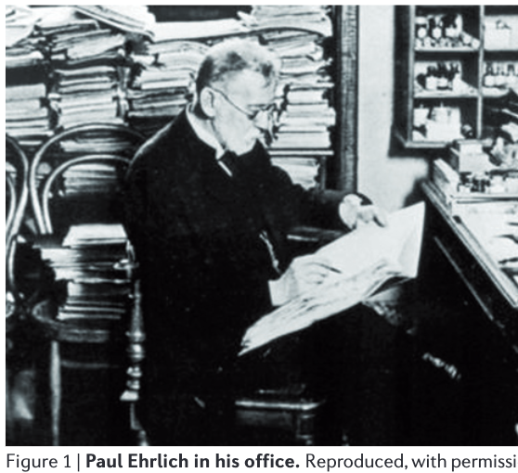
The ‘Magic Bullet’ Idea
Paul Ehrlich was born on March 14, 1854
Nobel Prize in Physiology or Medicine in 1908 in recognition of his work on immunity.
Ever since [...] chemotherapy, science had sought to increase the specificity of such treatments by developing compounds with greater selectivity for killing cancer cells.
The notion of combining specific binding to a diseased cell or organism with a toxic activity for that cell or organism was first articulated by Paul Ehrlich in 1907. He referred to “magic bullets” to describe such molecules.
As the specific binding properties and protein structure of antibodies became known, there were early attempts to conjugate cytotoxic drugs to serum immunoglobulins to provide specificity to such agents.
However, it was not until the invention of monoclonal antibodies in 1975 that the concept that antibodies could provide to a cell-killing agent the selective binding became the subject of a large research effort.
(~Lambert, 2015)
Slide courtesy of A. Katharina Wilkins

Slide 6
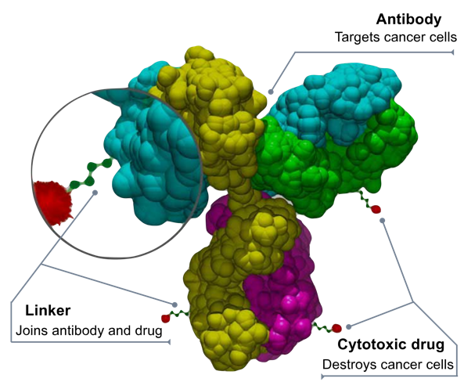
What are antibody-drug conjugates (ADCs)?
ADCs are targeted cancer therapies that combine the specificity of monoclonal antibodies (mAbs) with the potency of cytotoxic drugs
Goal: Deliver chemotherapy selectively to cancer cells, reducing off-target toxicity
By Bioconjugator - Own work, CC BY-SA 4.0, https://commons.wikimedia.org/w/index.php?curid=58772304

Slide 7
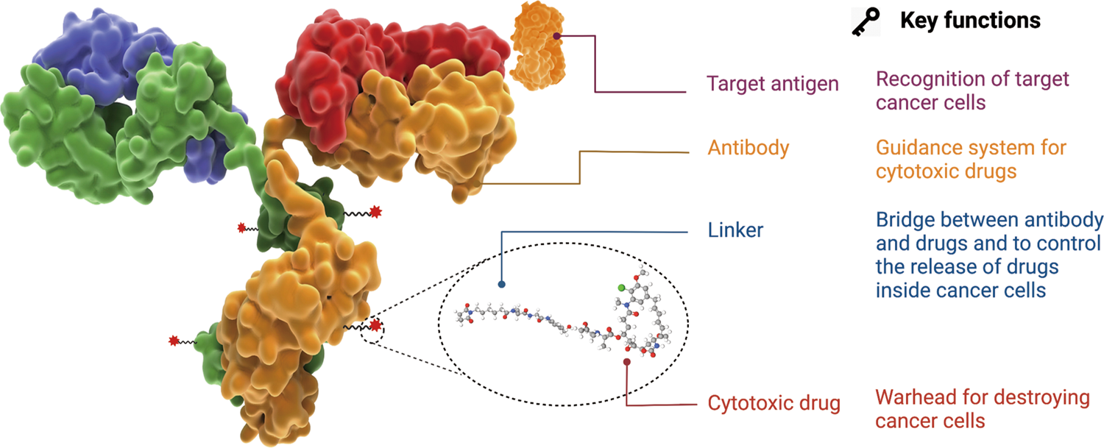
What are antibody-drug conjugates (ADCs)?
Fu, Z., Li, S., Han, S. et al. Antibody drug conjugate: the “biological missile” for targeted cancer therapy. Sig Transduct Target Ther 7, 93 (2022). https://doi.org/10.1038/s41392-022-00947-7

Slide 8
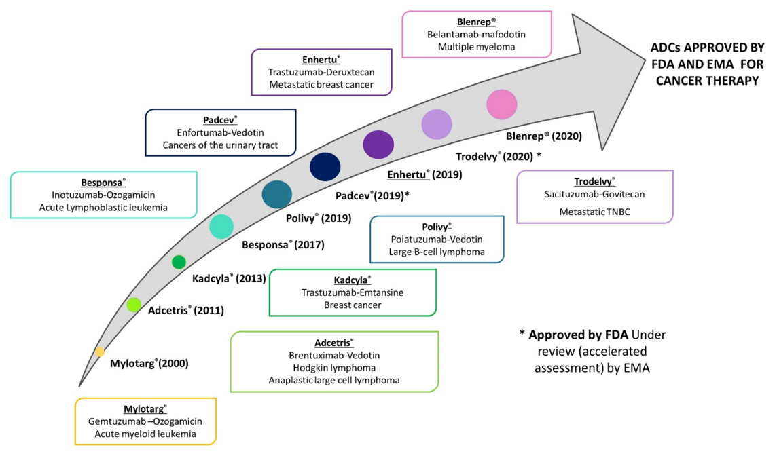
ADC approvals
Martín-Sabroso C, Lozza I, Torres-Suárez AI, Fraguas-Sánchez AI. Antibody-Antineoplastic Conjugates in Gynecological Malignancies: Current Status and Future Perspectives. Pharmaceutics. 2021; 13(10):1705.

Slide 9
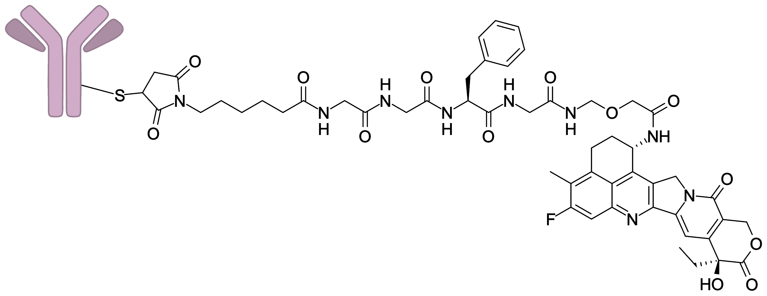
HER3-DXd
aka Patritumab deruxtecan
ADC consisting of a fully human monoclonal antibody against human epidermal growth factor receptor 3 (HER3)
Attached to a topoisomerase I inhibitor payload (DXd) via a tetrapeptide-based cleavable linker

Slide 10
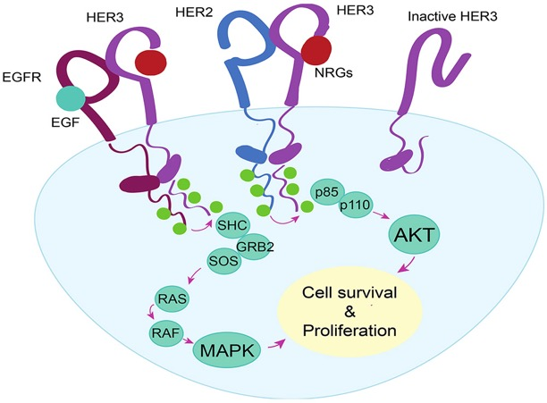
Why HER3?
HER3 overexpression has been observed in several cancers, including breast (BC), colorectal, and non-small cell lung cancer (NSCLC)
HER3 expression has been associated with shorter time to metastatic progression and shorter relapse-free survival
Haikala HM, Jänne PA. Thirty Years of HER3: From Basic Biology to Therapeutic Interventions. Clin Cancer Res. 2021 Jul 1;27(13):3528-3539.

Slide 11
HER3-DXd
Population PK

Slide 12
HER3-DXd studies
Study | Patients | # Subjects
U31402-A-J101 | HER3-positive metastatic breast cancer | 182
U31402-A-U102 | NSCLC | 237
U31402-A-U201 | Metastatic or locally advanced NSCLC with an activating EGFRm | 274
U31402-A-U202 | Advanced or metastatic colorectal cancer who are resistant, refractory, or intolerant to ≥2 prior lines of therapy | 40

Slide 13
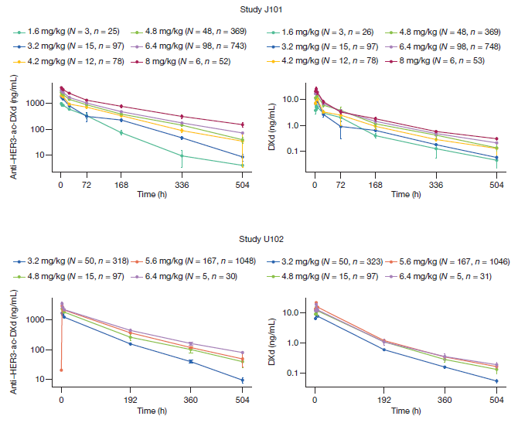
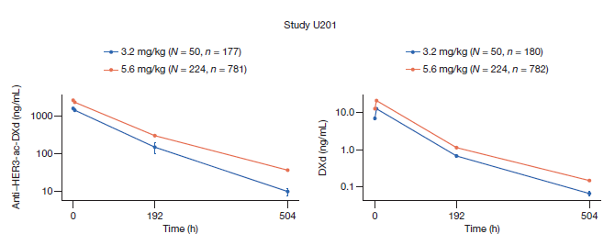
21,750 PK samples from 733 subjects
Study J101
Study U201
Study U102
Study U202
5.6 mg/kg IV Q3W
N = 40 subjects

Slide 14
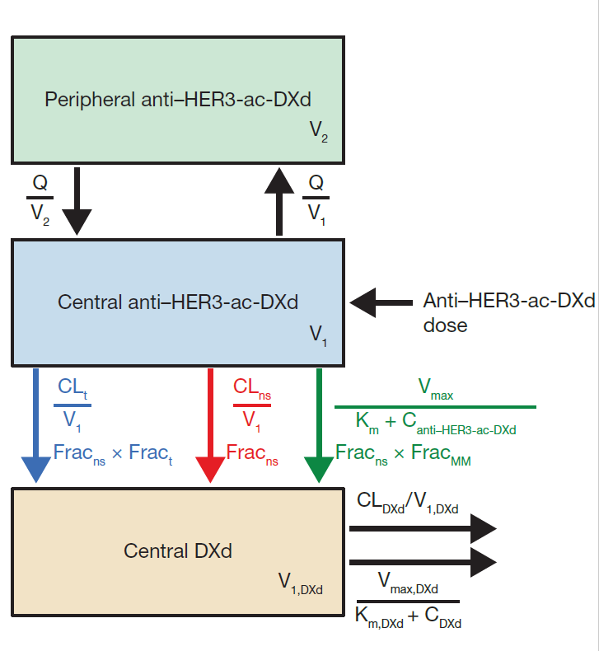
PK model structure
Anti–HER3-ac-DXd PK: two-compartment model with three elimination pathways:
linear transient clearance
nonspecific time-dependent clearance
nonlinear Michaelis-Menten clearance
DXd PK: one-compartment model with two clearance pathways:
linear clearance
nonlinear Michaelis-Menten clearance
DXd formation rate limited by all three clearance pathways of anti–HER3-ac-DXd

Slide 15
Clearance pathways: Nonspecific time-dependent linear clearance
Clinf: nonspecific linear clearance at infinity after dosing Q3W
CLinf,Emax: maximum effect of time on CLns
T50: the time to half-maximal effect
γ: Hill coefficient

Slide 16
Clearance pathways: Transient linear clearance
CLT: clearance at baseline
kdes: rate constant of exponential decline

Slide 17
Clearance pathways: Nonlinear clearance
Vmax: maximal Michaelis-Menten elimination
Km: exposure eliciting half of the maximum effect
$${\text{CL}}_{\text{MM}}=\frac{V_{\text{max}}}{K_{\text{m}}+C_{\text{anti}\text{-}\text{HER}\text{3-}\text{ac}\text{-}\text{DXd}}}$$

Slide 18
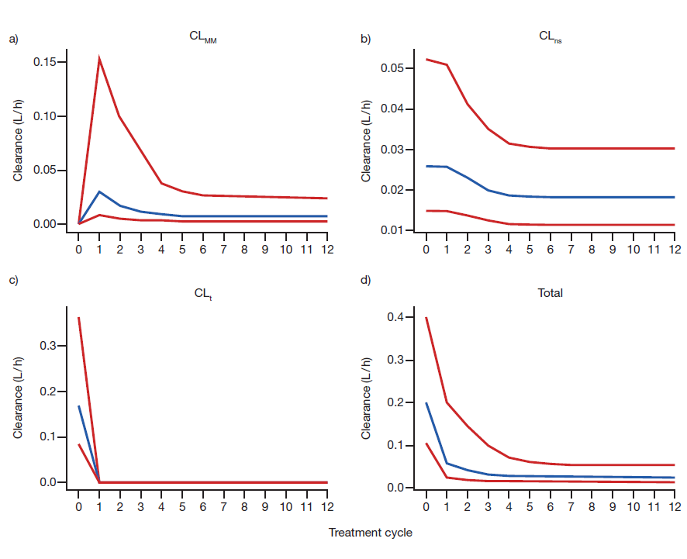
Clearance components over time
CL_{MM}
CL_{ns}
CL_{t}
Total

Slide 19
Full covariate model
Anti–HER3-ac-DXd covariate effects
DXd covariate effects
CL_{t}: hepatic function, CRCL, prior therapies
V1: sex, country
CL_{inf}: country, sex, age, tumor type, prior chemo, prior immunotherapy, ECOG, prior therapies, hepatic function, CRCL, formulation
CL_{inf,Emax}: albumin, tumor size
CL_{DXd}: country, sex, age, tumor type, prior chemo, prior immunotherapy, ECOG, prior therapies, hepatic function, CRCL, formulation
V_{DXd}: sex, country

Slide 20
Reduced covariate model
Anti–HER3-ac-DXd covariate effects
DXd covariate effects
CL_{t}: hepatic function, CRCL, prior therapies
V1: sex, country
CL_{inf}: country, sex, age, tumor type, prior chemo, prior immunotherapy, ECOG, prior therapies, hepatic function, CRCL, formulation
CL_{inf,Emax}: albumin, tumor size
CL_{DXd}: country, sex, age, tumor type, prior chemo, prior immunotherapy, ECOG, prior therapies, hepatic function, CRCL, formulation
V_{DXd}: sex, country
Covariates selected when relative exposures had 95% CI within 0.8 to 1.25, compared to reference subject

Slide 21
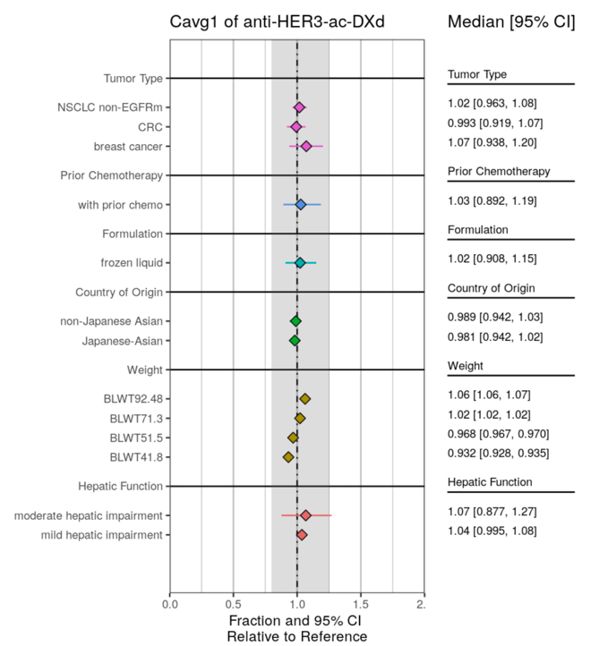
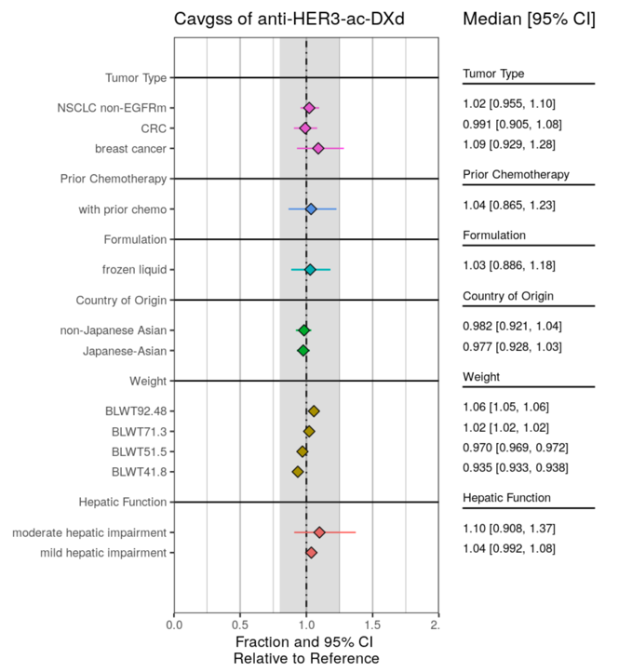
No clinically-relevant impact on anti-HER3-ac-DXd exposure

Slide 22
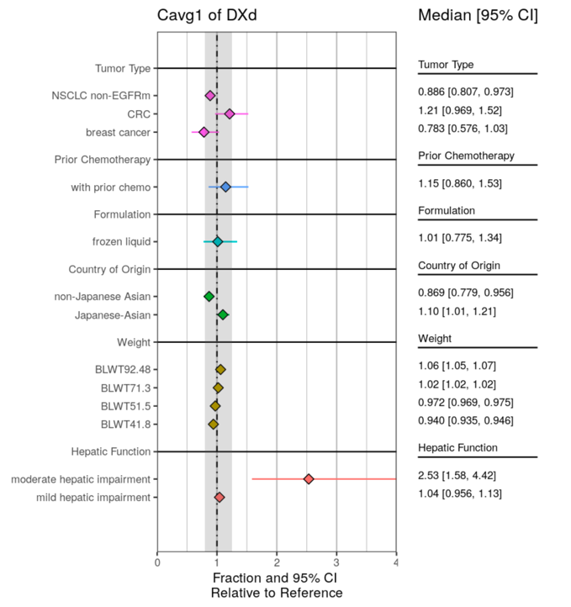
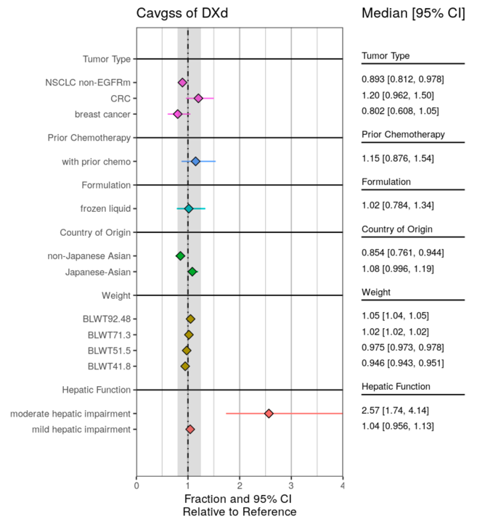
Potential hepatic impairment effect on DXd exposure (N = 8)
Moderate hepatic function

Slide 23
HER3-DXd
Efficacy Exposure-Response

Slide 24
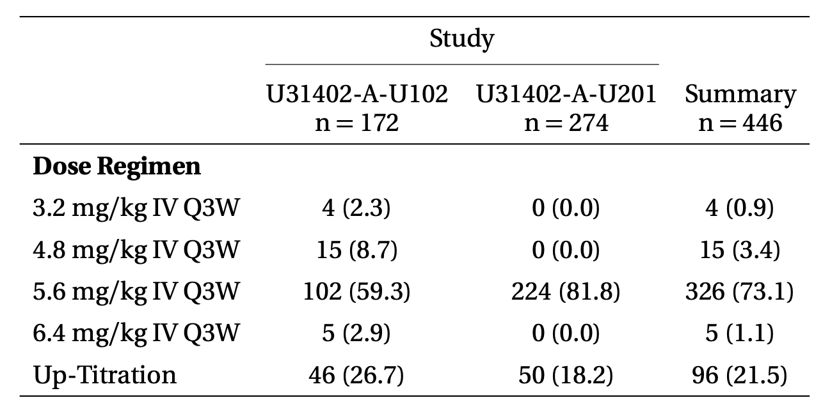
Efficacy data in patients with NSCLC
3.2 mg/kg, 4.8 mg/kg, followed by 6.4 mg/kg IV Q3W

Slide 25
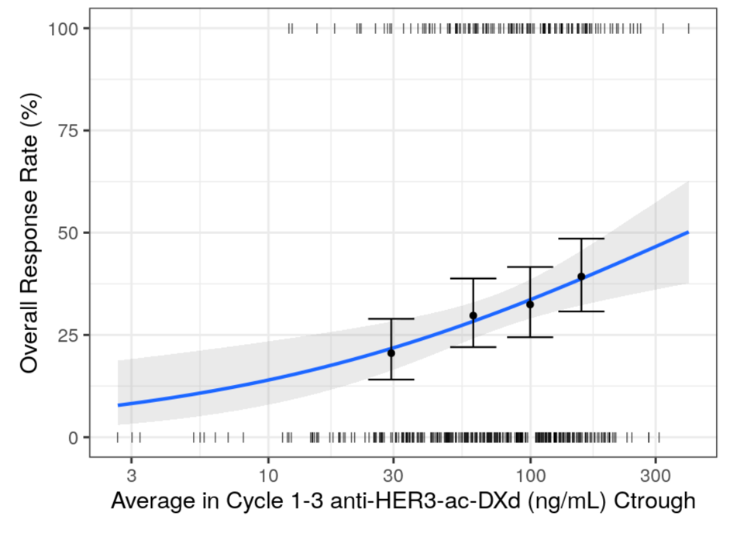
Overall Response Rate (ORR)

Slide 26
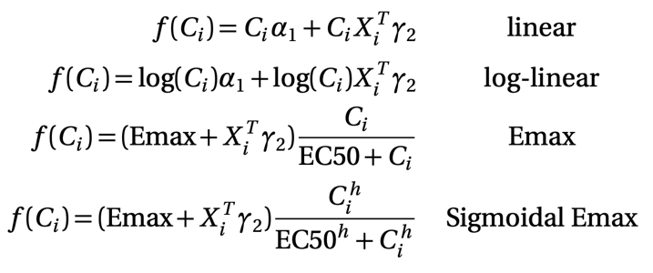
Logistic regression models fit in Stan/brms
Using weakly-informative priors
C is either C_{max}, C_{trough}, or C_{avg}
in Cycle 1 or average of Cycles 1 to 3
for either anti-HER3-ac-DXd or DXd
3 ⨉ 2 ⨉ 2 ⨉ 4 = 48 possible base models!

Slide 27
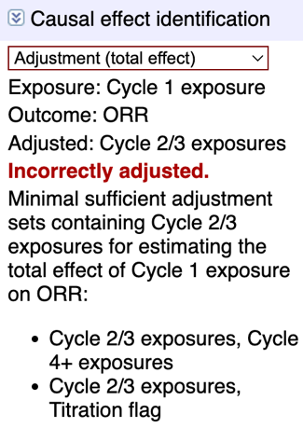
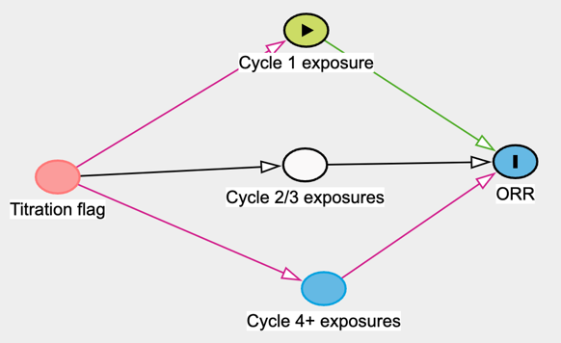
ORR: Causal inference suggests including titration regimen flag
https://www.dagitty.net/dags.html
3 ⨉ 2 ⨉ 2 ⨉ 2 ⨉ 4 = 96 possible base models!

Slide 28
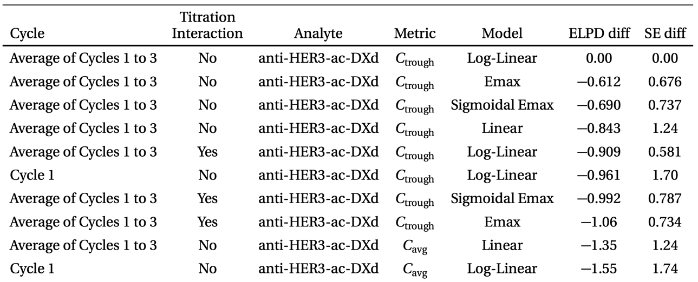
Exposure metric and ER function selected using ELPD & VPCs
(Expected Log Pointwise Density: higher is better!)

Slide 29
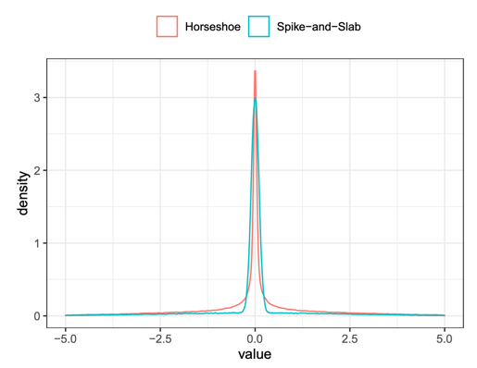
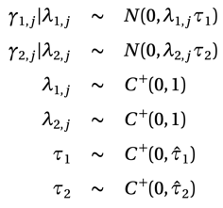
Covariate “selection” using horseshoe priors
Main effects (intercept) and interactions (slope)
age
sex
race
country
bodyweight
tumor size
ECOG
prior chemotherapy
prior immunotherapy
number of prior lines of therapy
prior third-generation TKI therapy
HER3 membrane staining (2+/3+) ≥75%
baseline bone/liver/brain metastasis
EGFR mutations
Priors selected such that the proportion of non-negligible main effects and interaction effects were 1/2 and 1/4, respectively

Slide 30
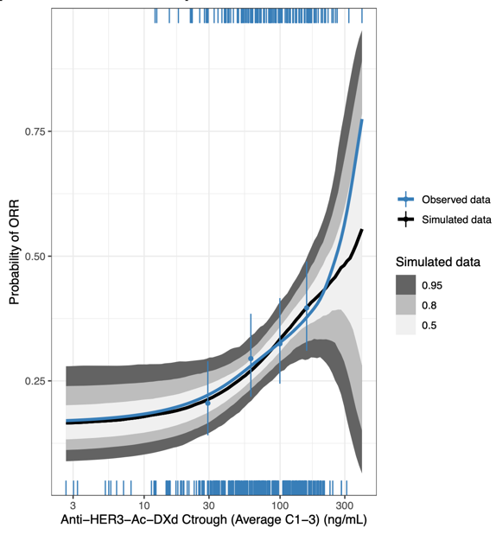
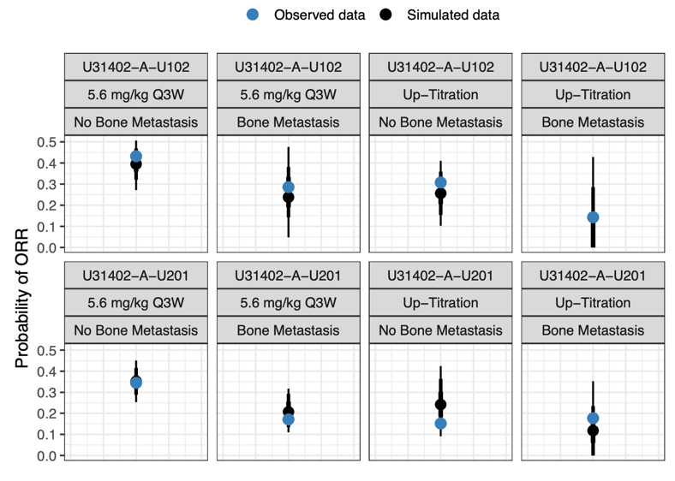
Model describes the data well

Slide 31
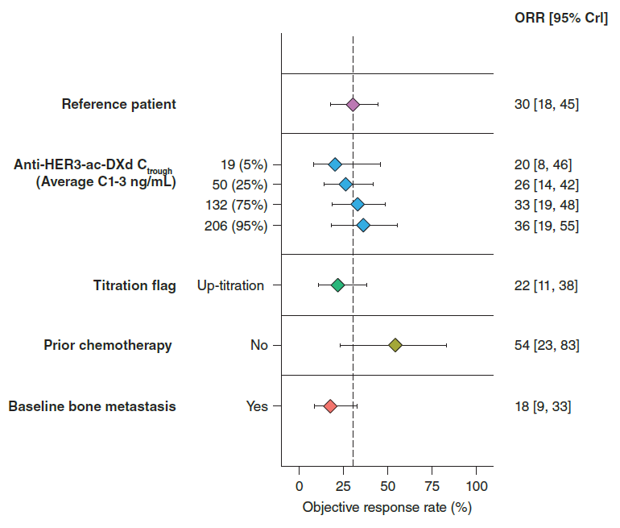
Most covariate effect estimates shrink to zero

Slide 32
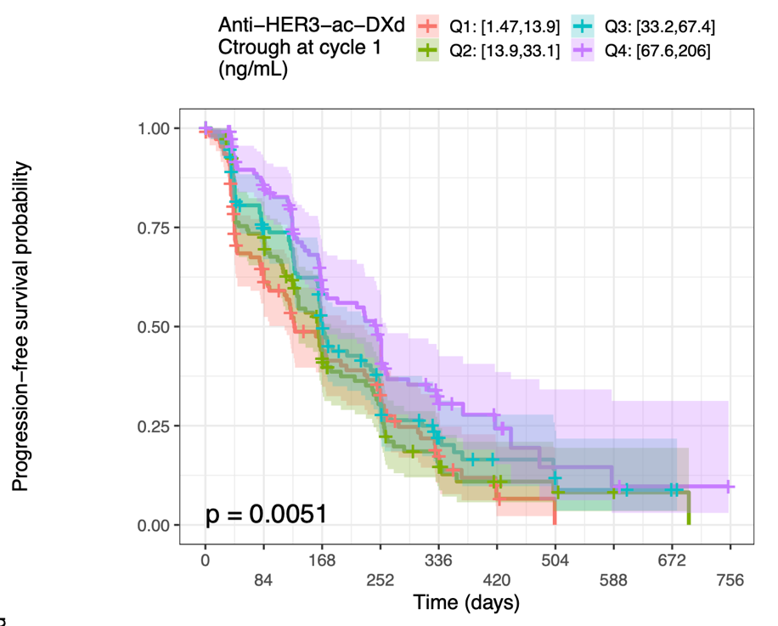
Progression-Free Survival (PFS)

Slide 33
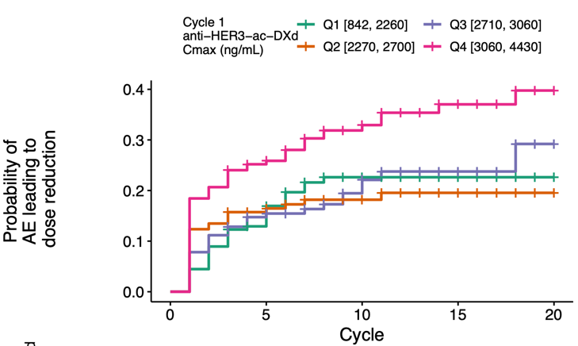
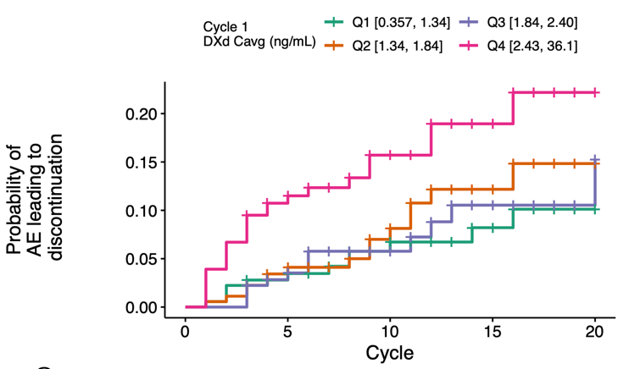
Dose reductions and discontinuations were common

Slide 34
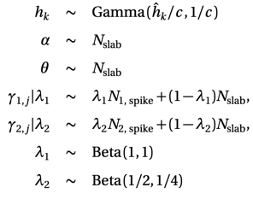
PFS modeled with time-varying exposure & hazard
Piecewise exponential time-to-event model
Same exposure metrics as ORR
Same ER functions as ORR
Same covariates as ORR
Spike & slab priors for covariates (shrinkage prior like horseshoe)
Interval censoring and right censoring
Parametric time-to-event models also considered

Slide 35
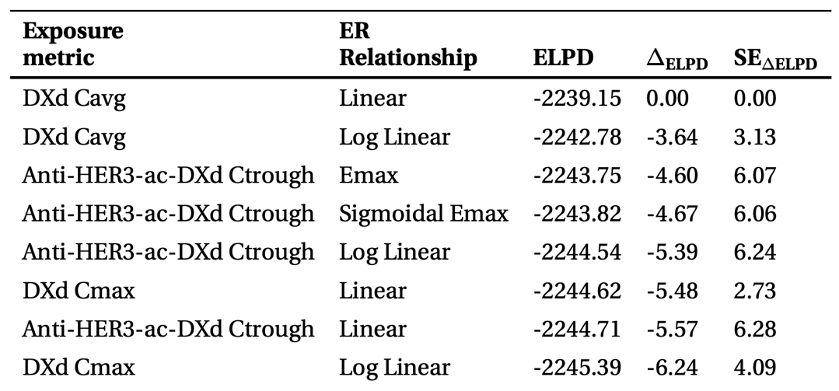
Same exposure & ER function as ORR comparable to “best” model
(Expected Log Pointwise Density: higher is better!)

Slide 36
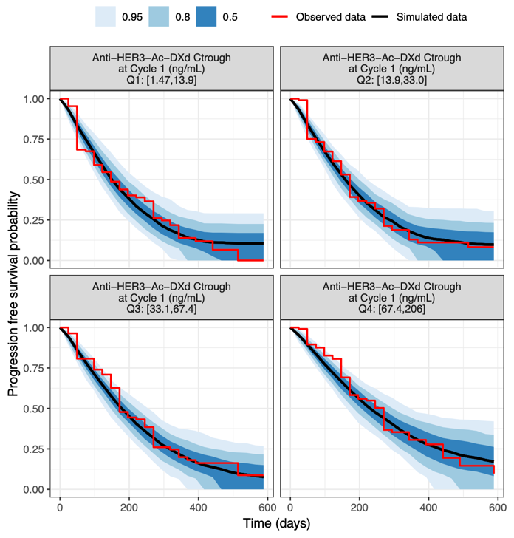
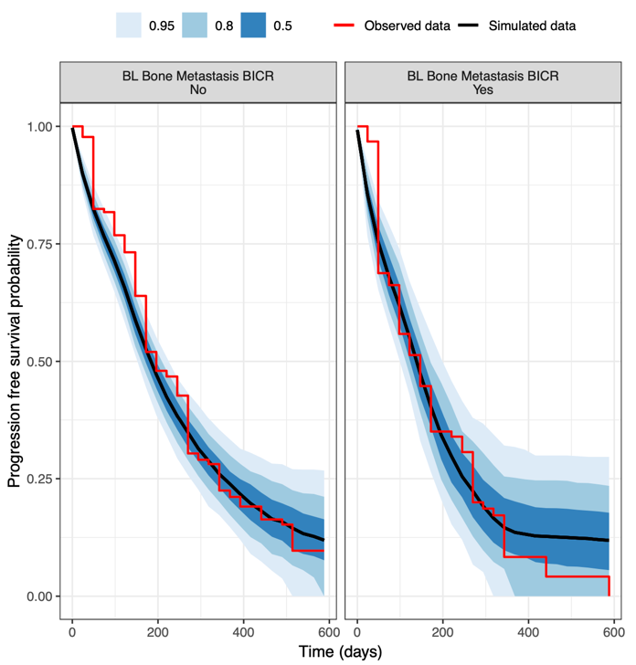
Model describes the data well

Slide 37
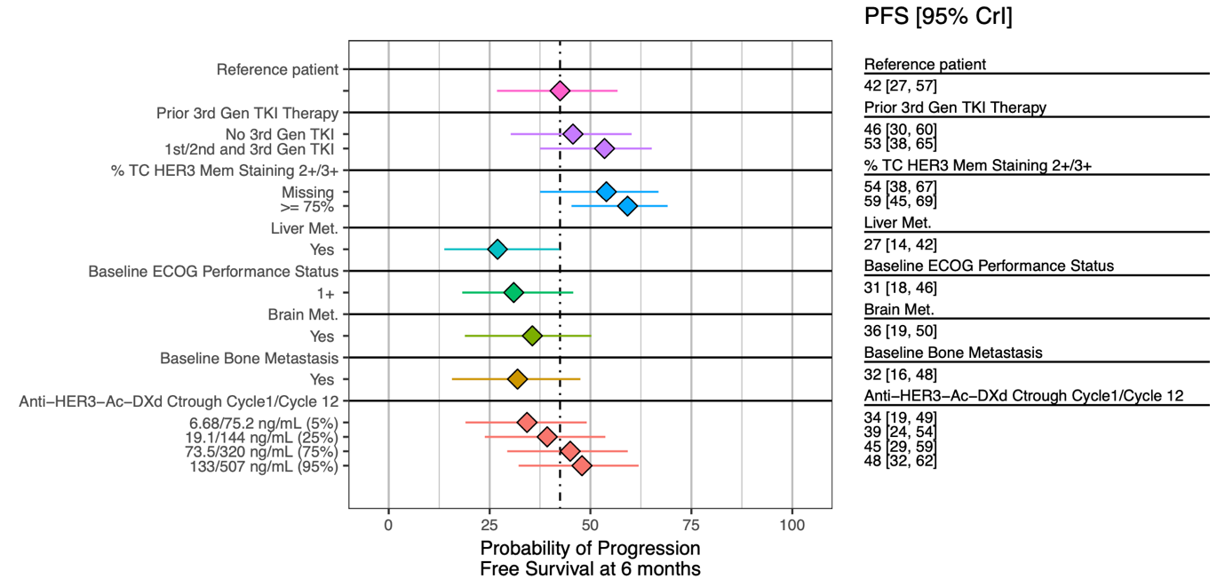
Most covariate effect estimates shrink to zero

Slide 38
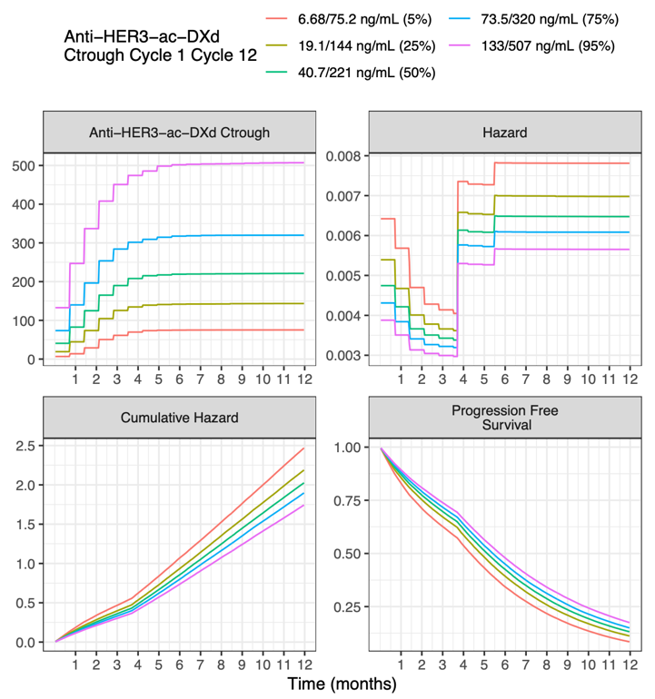
Piecewise exponential model allows for arbitrary changes in hazard

Slide 39
HER3-DXd
Safety Exposure-Response

Slide 40
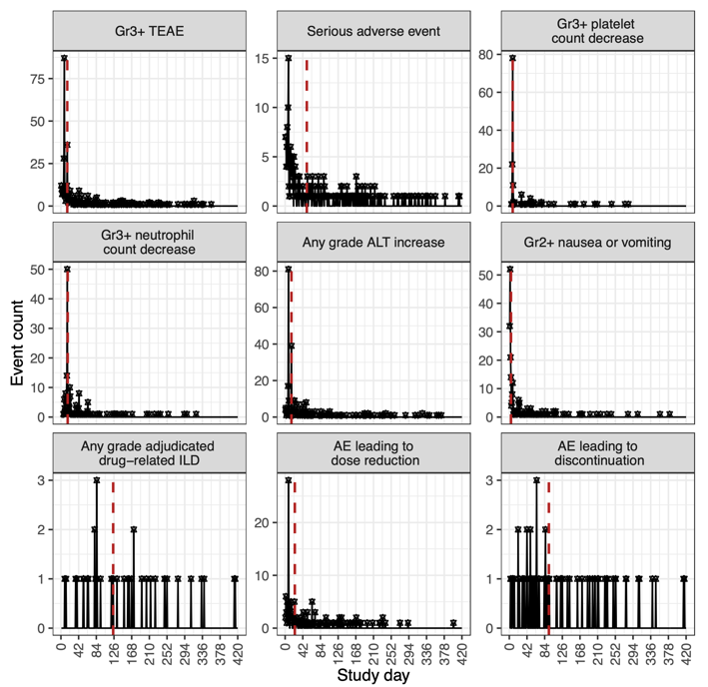
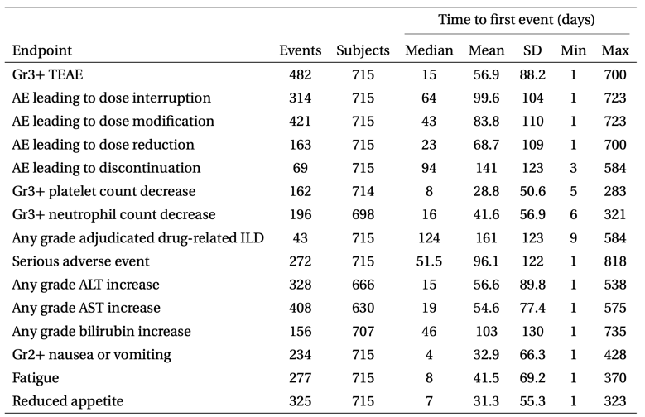
Safety endpoints modeled as either binary or time-to-event
Depending on time of first event

Slide 41
Most associations were with DXd exposure
Safety endpoint | Best-fitting analyte and PK exposure metric | Influential and significant covariates
Grade ≥3 TEAE | Cycle 1 DXd C_{avg} | Age
 |  | Race: Asian
Serious AE | Cycle 1 DXd C_{avg} | Age
 |  | Country of origin: Japan
Grade ≥3 platelet count decrease | Cycle 1 DXd C_{max} | Baseline hemoglobinª
 |  | Baseline platelet countª
 |  | Race: Asianª
 |  | Tumor type: Breast cancer
Grade ≥3 neutrophil count decrease | Cycle 1 DXd C_{max} | Weight
 |  | Baseline hemoglobin
 |  | Baseline neutrophil countª
 |  | Country of origin: Japanª
Grade ≥2 nausea or vomiting | Cycle 1 anti-HER3-ac-DXd C_{avg} | None
Any grade adjudicated drug-related ILD | Anti-HER3-ac-DXd C_{max} | None
AE leading to dose reduction | DXd C_{max} | Age
AE leading to discontinuation | DXd C_{avg} | None

Slide 42
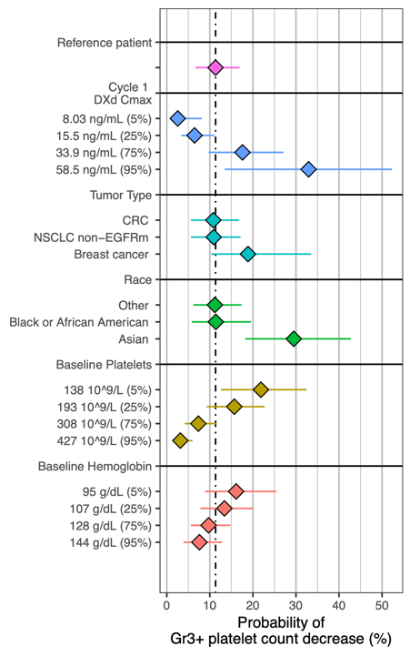
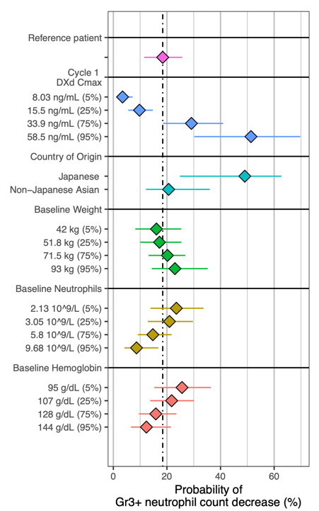
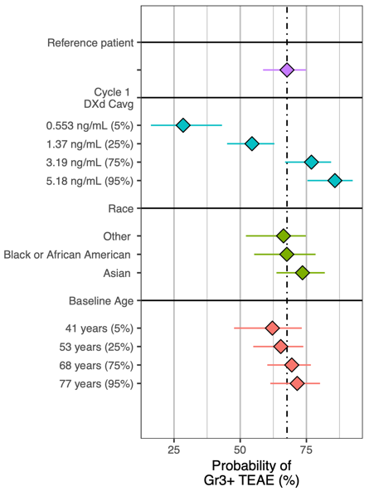
Only a handful of significant covariates on safety endpoints

Slide 43
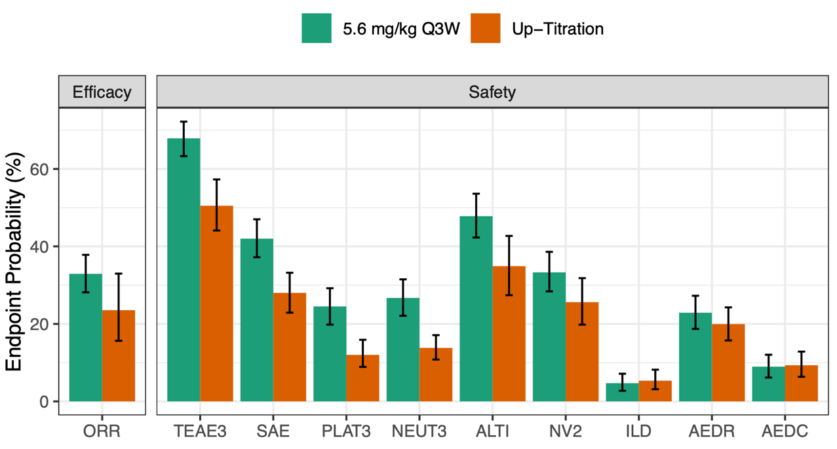
Population simulations support 5.6 mg/kg over up-titration
3.2 mg/kg, 4.8 mg/kg, followed by 6.4 mg/kg IV Q3W
AEDC, adverse events leading to discontinuation; AEDR, adverse events leading to dose interruption; DXd, deruxtecan; HER3, human epidermal growth factor receptor 3; ILD, interstitial lung disease; NEUT, neutrophil count decrease; NV, nausea or vomiting; PLAT, platelet count decrease; Q3W, every 3 weeks; SAE, serious adverse event; TEAE, treatment-emergent adverse event.

Slide 44
Summary

Slide 45
Summary
PK
Exposure-response
Anti–HER3-ac-DXd PK was described by a two-compartment model with three elimination pathways
DXd PK was described by by a one-compartment model with linear and nonlinear clearance
Most covariates did not have a clinically important impact on exposures
Moderate hepatic impairment was associated with in DXd exposure
No dose reduction is proposed at this time since moderate hepatic impairment data was limited
Objective response rate and progression-free survival were positively associated with anti-HER3-ac-DXd exposure
bone metastasis identified as a predictive covariate for ORR
liver metastasis identified as a predictive covariate for PFS
Grade ≥3 TEAEs, SAEs, and grade ≥3 platelet and neutrophil count decrease were positively correlated with increasing exposure to anti-HER3-ac-DXd or DXd
Dose-response predictions showed that HER3-DXd 5.6 mg/kg Q3W had a positive benefit-risk profile with clinically meaningful efficacy for NSCLC and manageable safety

Slide 46
Thank you

