Slide 1
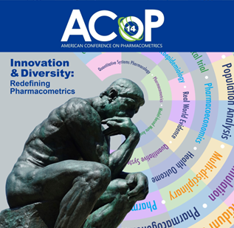
Hierarchical Deep Compartment Modeling: A Workflow to Leverage Machine Learning for Hierarchical Pharmacometric Modeling
Ahmed Elmokadem, Kiersten Utsey, Eric Jordie, and Timothy Knab
National Harbor, MD November 5 - 8, 2023

Slide 2
Biography
PhD in Biomedical Sciences from the University of Connecticut in 2017.
The same year, I joined Metrum Research Group as a Research Associate in the TSP (Translational and Systems Pharmacology) group.
Currently, I am a Senior Scientist at Metrum with many interests like PBPK and QSP modeling and integrating those with Bayesian analysis and machine learning tools.
National Harbor, MD November 5 - 8, 2023

Slide 3
What is this work about?
A workflow for Hierarchical Deep Compartment Modeling (HDCM) is introduced that integrates compartmental modeling, deep learning, and Bayesian inference.
HDCM allows for learning the functional relationship between covariates and compartmental model parameters in a hierarchical manner while quantifying the uncertainty around this relationship.
National Harbor, MD November 5 - 8, 2023

Slide 4
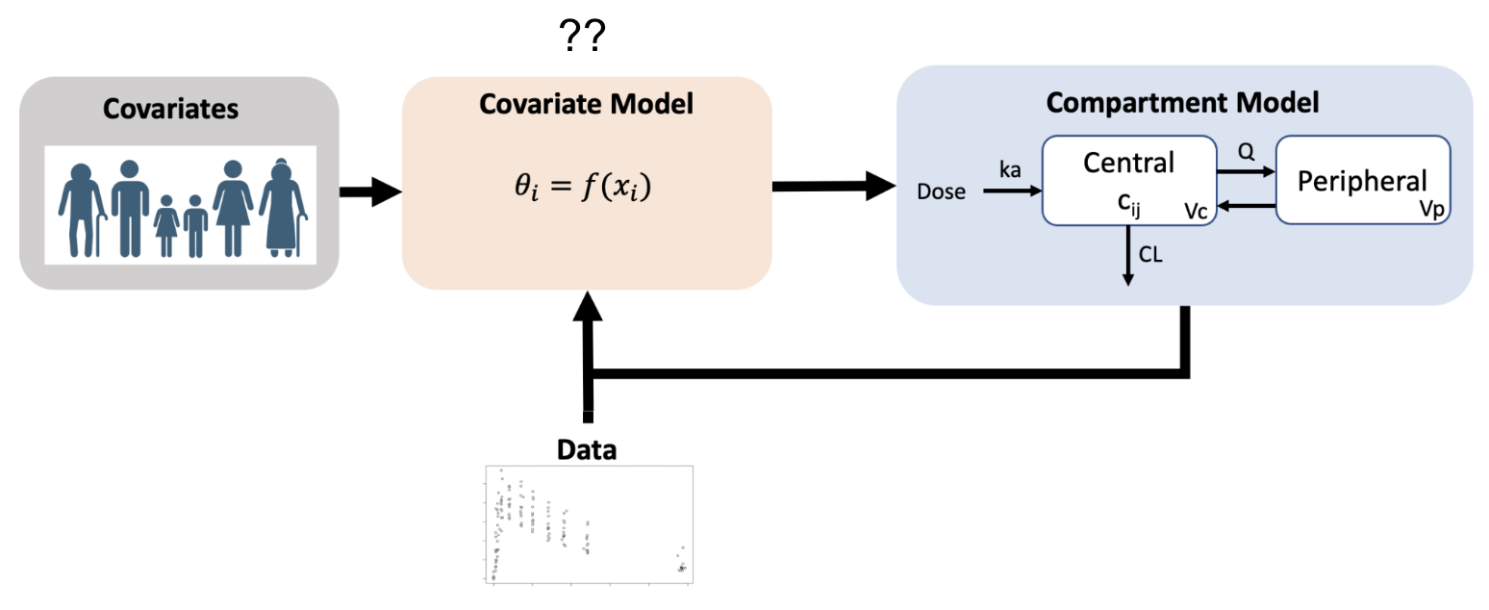
The Problem with covariate modeling!
??
Issues:
Functional form relating covariates to model parameters is typically unknown.
Process of choosing covariates is complex and tedious.
Some covariates cannot be practically applied.
National Harbor, MD November 5 - 8, 2023

Slide 5
Deep Compartment Modeling (DCM)
National Harbor, MD November 5 - 8, 2023

Slide 6
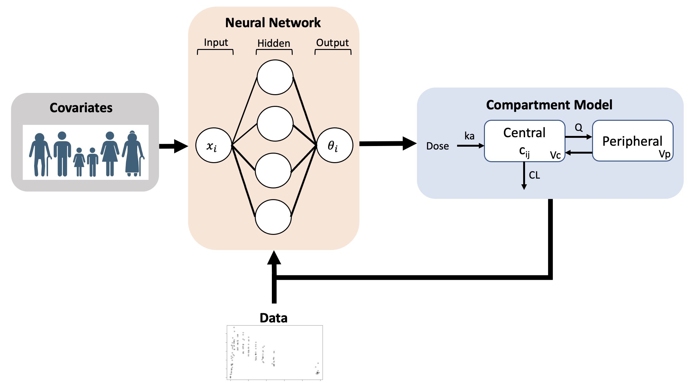
How does DCM differ?
Benefits:
Can learn the unknown functional form of covariate relation to model parameters.
Can use arbitrarily complex covariates.
Provides interpretable outputs.
Limitations:
No random effects were considered.
No measurement of uncertainty.
National Harbor, MD November 5 - 8, 2023

Slide 7
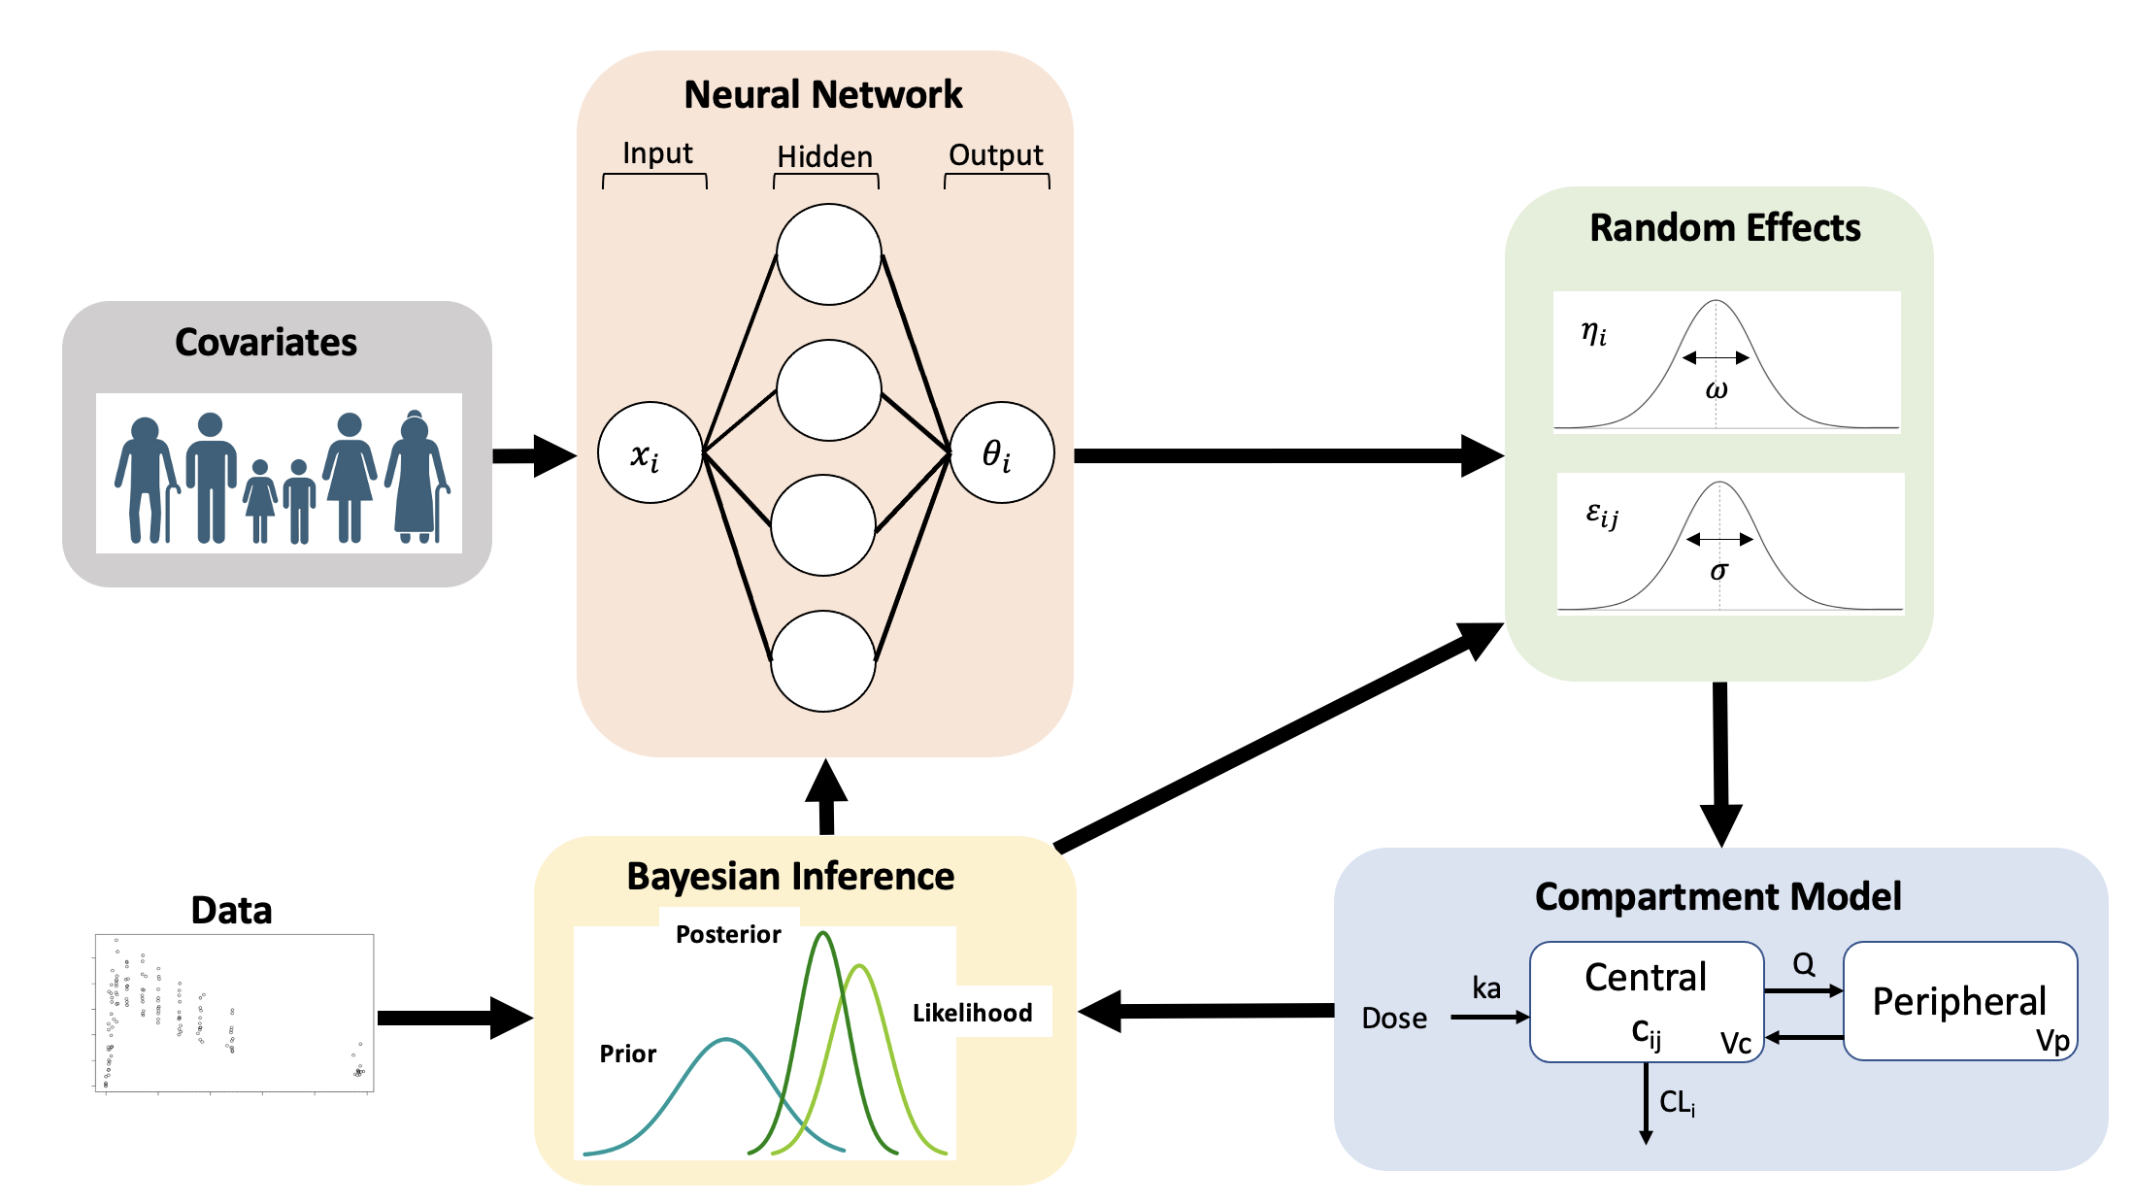
Hierarchical Deep Compartment Modeling (HDCM) workflow
National Harbor, MD November 5 - 8, 2023

Slide 8
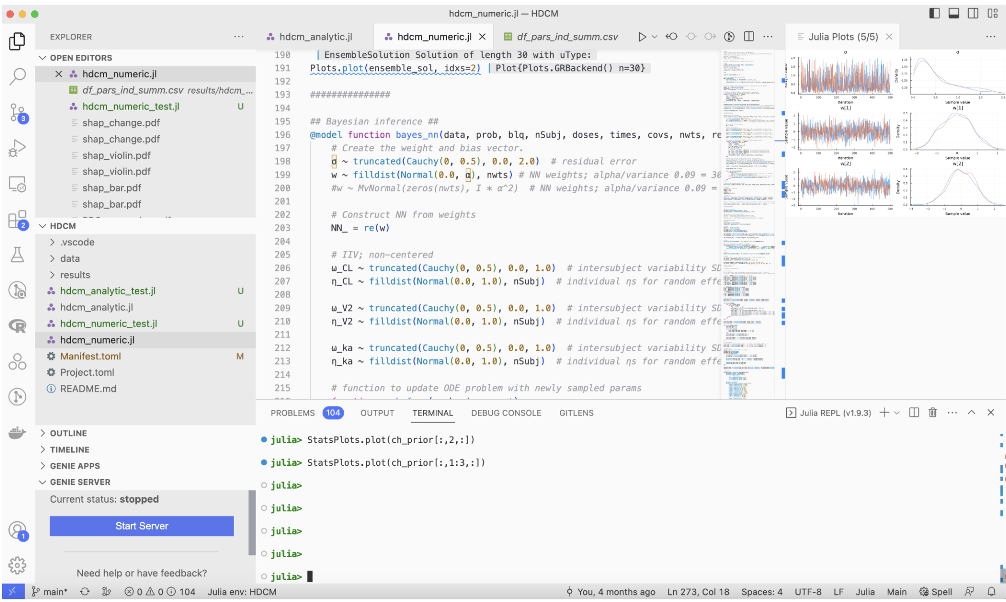
Example
National Harbor, MD November 5 - 8, 2023

Slide 9
Example
Synthetic PK data for 30 subjects: 10 train and 20 test.
4 covariates: Age, weight, EGFR, and albumin.
Neural network structure: input layer (4 nodes), hidden layer (6 nodes), and output layer (5 nodes).
Model run took about 12 minutes with MCMC chain parallelization.
Tools used: Open-source Julia packages:
DifferentialEquations.jl: for building the compartmental model
Flux.jl and DiffEqFlux.jl: for machine learning integration
Turing.jl: for running the Bayesian analysis
National Harbor, MD November 5 - 8, 2023

Slide 10
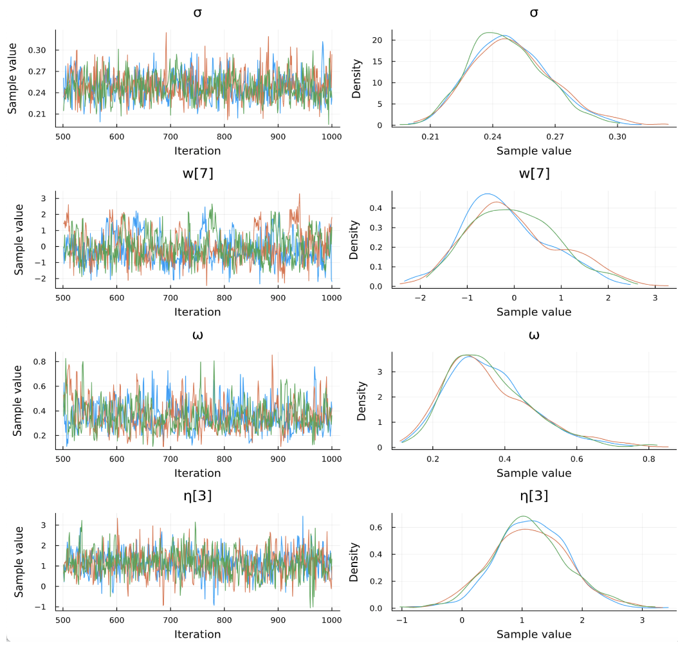
Do we have convergence?
National Harbor, MD November 5 - 8, 2023

Slide 11
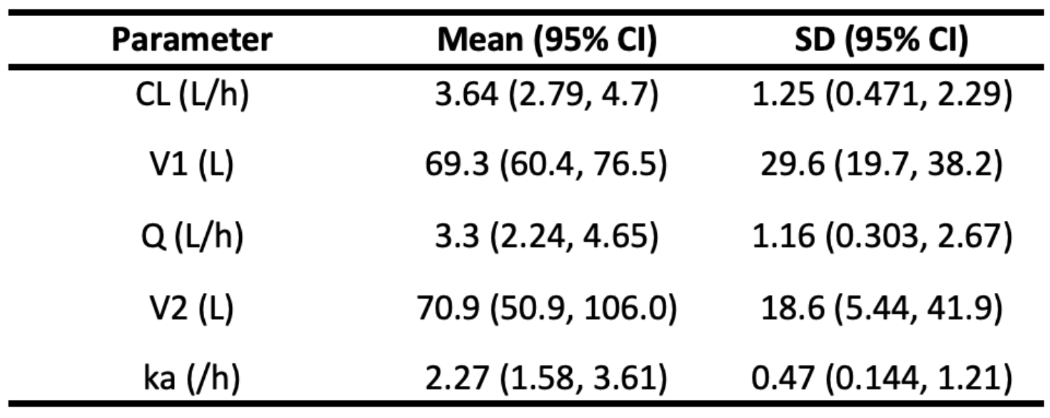
HDCM provides interpretable outputs
The workflow provides interpretable compartmental model parameters. This is carried out via simultaneously:
inferring the typical compartmental model parameters from covariates
inferring the random effects
quantifying the uncertainty around all parameters
National Harbor, MD November 5 - 8, 2023

Slide 12
Does HDCM characterize training data?
National Harbor, MD November 5 - 8, 2023

Slide 13
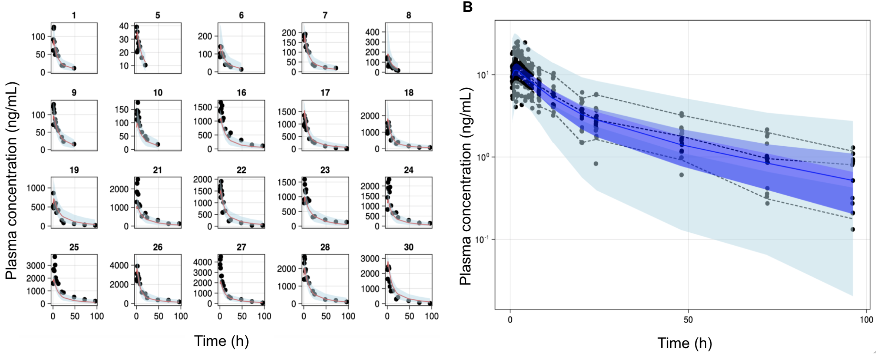
Does HDCM overfit?
National Harbor, MD November 5 - 8, 2023

Slide 14
SHapley Additive exPlanation (SHAP) to quantify the impact of covariates on model parameters
National Harbor, MD November 5 - 8, 2023

Slide 15
Summary
A workflow for HDCM was introduced that integrates compartmental modeling, deep learning, and Bayesian inference.
HDCM allows for learning the functional relationship between covariates and compartmental model parameters in a hierarchical manner while quantifying the uncertainty around this relationship.
This approach allows for the implementation of arbitrarily complex covariates while simultaneously quantifying the random effects.
Recent progress: We have successfully extended the approach to characterize more IIV on more parameters.
National Harbor, MD November 5 - 8, 2023

Slide 16
Acknowledgements
Metrum TSP group
Metrum AI/ML SIG
Matthew Wiens
Stacey Tannenbaum
Matthew Riggs
Julia:
SciML organization
Flux.jl
Turing.jl
National Harbor, MD November 5 - 8, 2023

