Slide 1

Tutorial: The Role of Pharmacometrics in Advancing Quantitative Benefit-Risk Assessments for Drug Review and Approval
Chairs: Arnab Mukherjee and Tim Nicholas
The confluence of Statistical and Pharmacometric Approaches for Benefit Risk Analysis: a case study using Bayesian joint models for safety and efficacy
Jonathan L French, ScD
Metrum Research Group
Orlando, FL October 20 – 23, 2019

Slide 2
Outline
Case Study
  Setting the scene
  Multivariate benefit-risk
  Bayesian joint dose-response model
  Using the model to inform decisions
Multi-criteria decision analysis
  Concepts & methods
  Conceptual application to case study

Slide 3
Ladies and gentlemen, the story you are about to see is true.
The names have been changed to protect the innocent.

Slide 4
Background
A drug was in Phase 2 development for the treatment of a chronic disease affecting over 20 millions adults in the US
Approved products are efficacious but have potentially life-threatening safety risks
Based on pre-clinical data, the drug was predicted to have fewer safety concerns while achieving equivalent efficacy as the marketed products.

Slide 5
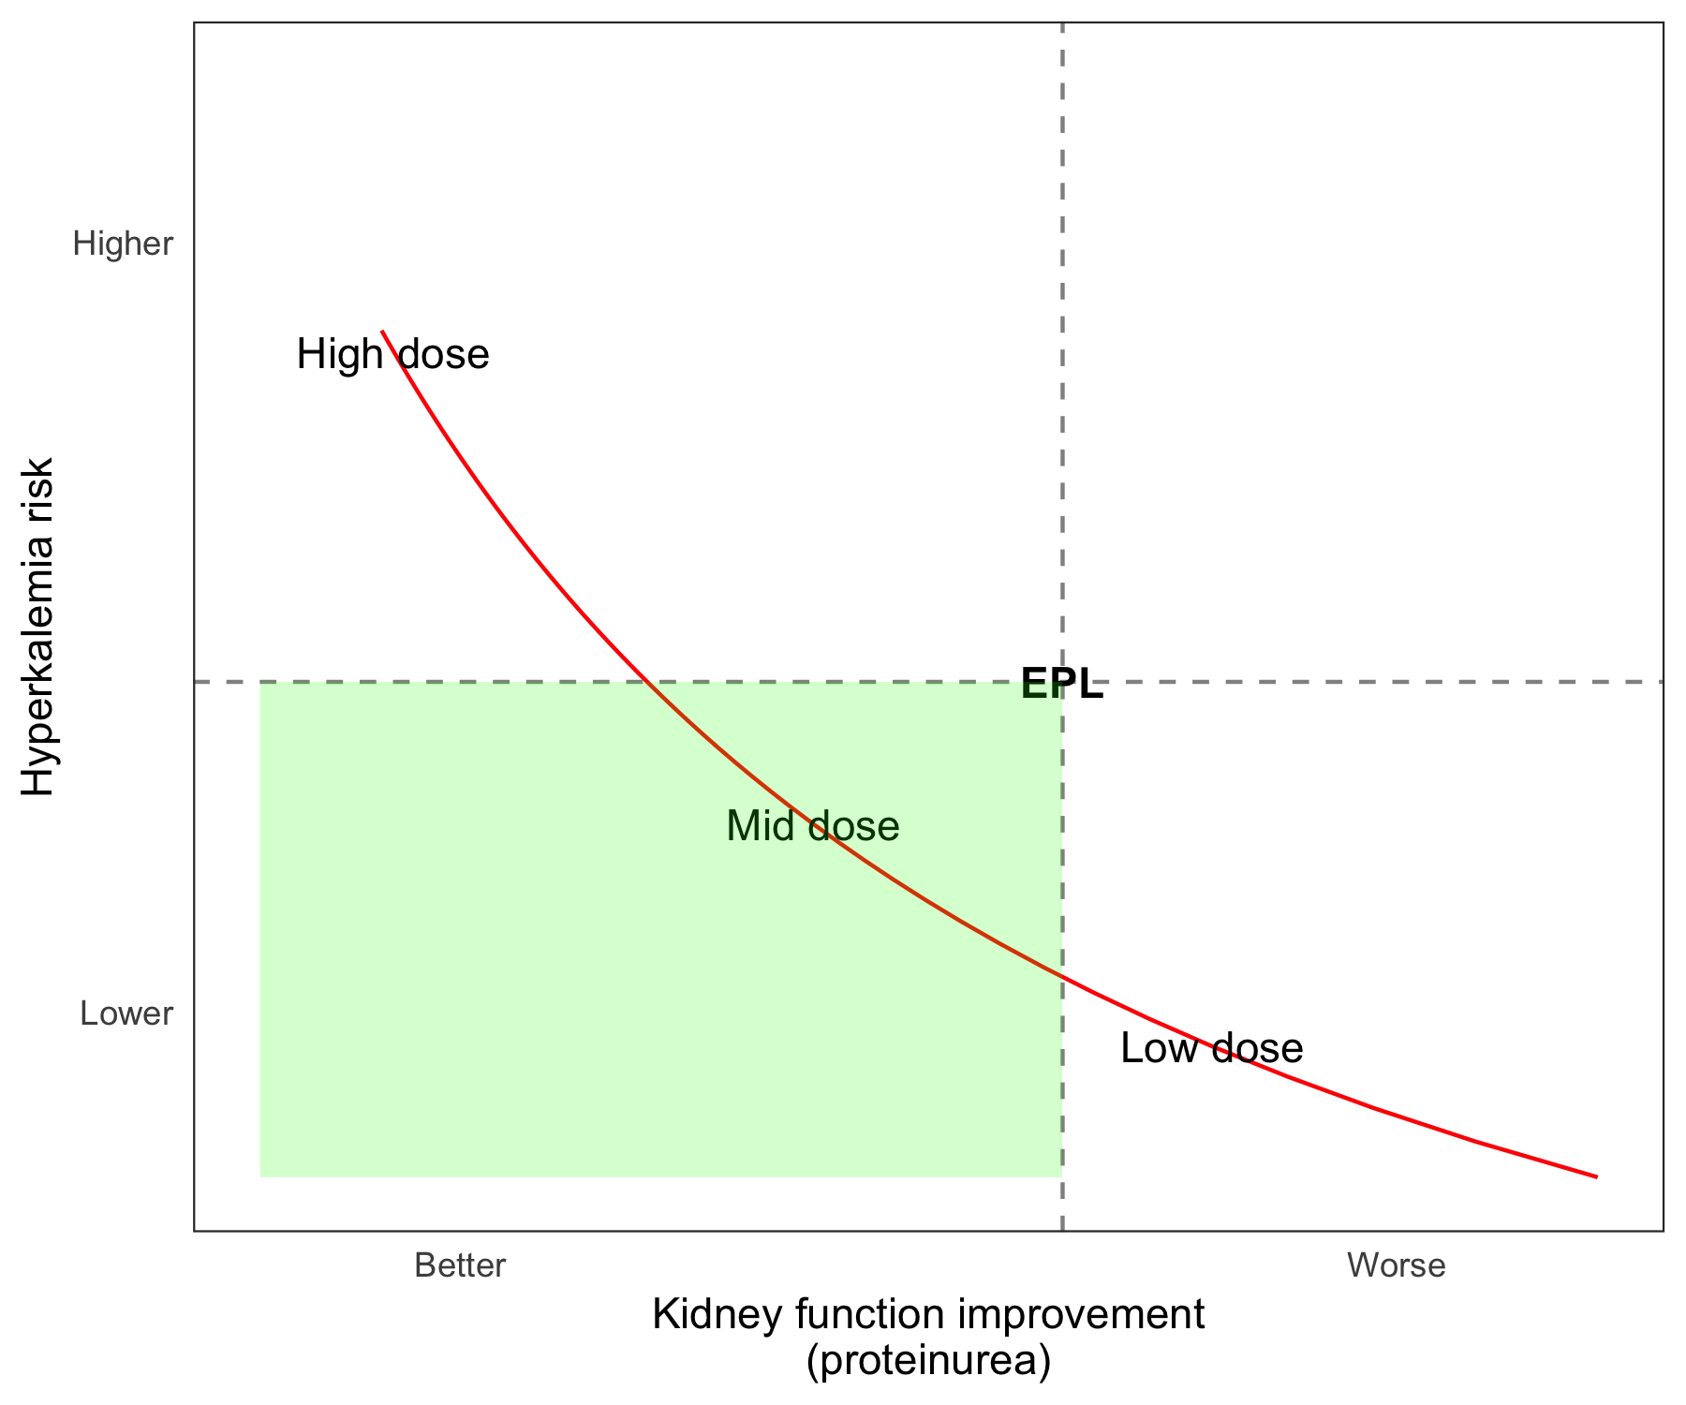
Key drug development decision
Is there a dose of with desired risk-benefit profile?
  Lower safety risk and equivalent (or better) efficacy
  More improvement in efficacy and equivalent (or better) safety
Risk-benefit is with respect to marketed treatment, not absolute
Hypothetical risk-benefit curve
Safety risk
Comparator
Efficacy benefit
Notes:
e

Slide 6
A dose-ranging, positive control, 2-period crossover trial informed the decision
Efficacy:
One PD Biomarker
Safety:
Two mechanism-related biomarkers
Incomplete block design
Three dose levels: Low, middle, high
Comparator
ClinicalTrials.gov Identifier: NCT01427972
Notes:
42 subjects enrolled
Each patient received 2 different dose levels, or one dose level and comparator

Slide 7
To address the risk-benefit question, we fit (Bayesian) joint models to the three endpoints
Counterfactual
Placebo
response
Baseline in
period 1
Period
effect
Dose-response
Effect of Comparator

Slide 8
Endpoint association modeled through correlated random effects
Subject-specific Baseline, Period and (counterfactual) placebo effects:
Subject-specific random effects modeled with full-block variance matrix:

Slide 9
Bayesian framework provided benefits
Readily answer key questions in a probabilistic framework.
Allows us to include moderately informative prior distributions on the population-level (counterfactual) placebo response
  Weakly informative prior distributions on other parts of the model
No need to rely on asymptotic theory to obtain uncertainty in estimates and predictions

Slide 10
Two key metrics were used to inform the decision-making process
Bi-variate (safety + efficacy) dose-response
Posterior probability of dose achieving safety and efficacy targets

Slide 11
Clear dose-response for safety endpoint 1
Outcome (lower is safer)
Posterior distribution for comparator-equivalent dose
Low
Medium
High
Comparator
Comparator-equivalent dose
Dose
Shaded areas represent 80% credible intervals

Slide 12
However, shallower dose-response for efficacy and safety endpoint 2
Outcome
Efficacy endpoint
(lower is better)
Safety endpoint 2
(higher is better)
Outcome
Low
Medium
High
Comparator
High
Comparator
Dose
Low
Medium
Dose
Shaded areas represent 80% credible intervals

Slide 13
Bivariate efficacy-safety dose-response shows unlikely to achieve desired risk-benefit profile
High
Low
Safety endpoint 1 relative to comparator
(lower is safer)
Mid
Safety endpoint 2 relative to comparator
(higher is safer)
Mid
Low
High
Efficacy relative to comparator
(lower is more effective)
Efficacy relative to comparator
(lower is more effective)

Slide 14
The probability of achieving the target is low at all doses studied
Probability
Probability
Safety endpoint 1 and efficacy
Safety endpoints 1 + 2 and efficacy
Better efficacy &
much better safety
Better efficacy &
much better safety
Better efficacy & safety
Better efficacy & safety
Dose
Dose

Slide 15
Alternatives / extensions to our approach
Mt-Isa et al. Balancing benefit and risk of medicines: a systematic review and classification of available methodologies. Pharmacoepidemiology and Drug Safety 2014. DOI: 10.1002/pds.3636.
http://protectbenefitrisk.eu/

Slide 16
Multi-Criteria Decision Analysis
“A methodology for appraising alternatives on individual, often conflicting criteria, and combining them into one overall appraisal” (Keeney and Raiffa, 1993)
Explicitly states
  which criteria are relevant
  the importance attached to each
  how to use this information to assess competing products
Discussion of using PK/PD models as input to MCDA (Bellanti et al., 2015)
Notes:
There are many flavors of MCDA…. I’ll just talk about the method in broad strokes.

Slide 17
MCDA is used to support health care decisions across a wide variety of areas
Decision maker | Example decision | Example criteria | Examples of stakeholders providing preferences
Life sciences companies | Portfolio decision analysis | Relevant aspects of benefits and risk, probability of success | Therapeutic area team; board of directors
Regulators | Benefit-risk assessment | Aspects of benefits and risks | Regulatory committees and/or patients
HTA bodies | Health technology assessment (HTA) | Effectiveness, patient need, burden of disease | HTA committees or general public
Prioritization of patients for health care services | Prioritizing patients’ access to health care | Measures of patient “need”; ability to benefit | Patient groups; health professionals;
Adapted from Thokala P, et al. Multiple Criteria Decision Analysis for Health Care Decision Making—An Introduction: Report 1 of the ISPOR MCDA Emerging Good Practices Task Force. Value Health. 2016; 19: 1-13.

Slide 18
Six steps to MCDA
MCDA Step | Description
Define the decision problem | Objectives, type of decision, alternatives
Select criteria on which to base assessment | Identify endpoints / measures relevant to the decision
Measure performance on the criteria | Quantify (expected) effects on criteria of interest. If no data, may be elicited.
Define ‘scoring’ | Translate effects to a ‘utility’ scale (delineates preferences within criteria).
Elicit weighting criteria | Weights delineates preferences between criteria. Will depend on stakeholder
Adapted from Thokala P, et al. Multiple Criteria Decision Analysis for Health Care Decision Making—An Introduction: Report 1 of the ISPOR MCDA Emerging Good Practices Task Force. Value Health. 2016; 19: 1-13.
Notes:
Measuring performance is in our wheelhouse. Generally based on data (and models).
Weights are elicited (compositional and decompositional methods)
And will vary depending on stakeholder
- Depending on decision-maker the appropriate stakeholder may not be well-defined
- Is there a single stakeholder for a regulatory decision?
Different stakeholders may have very different scoring functions and weights.

Slide 19
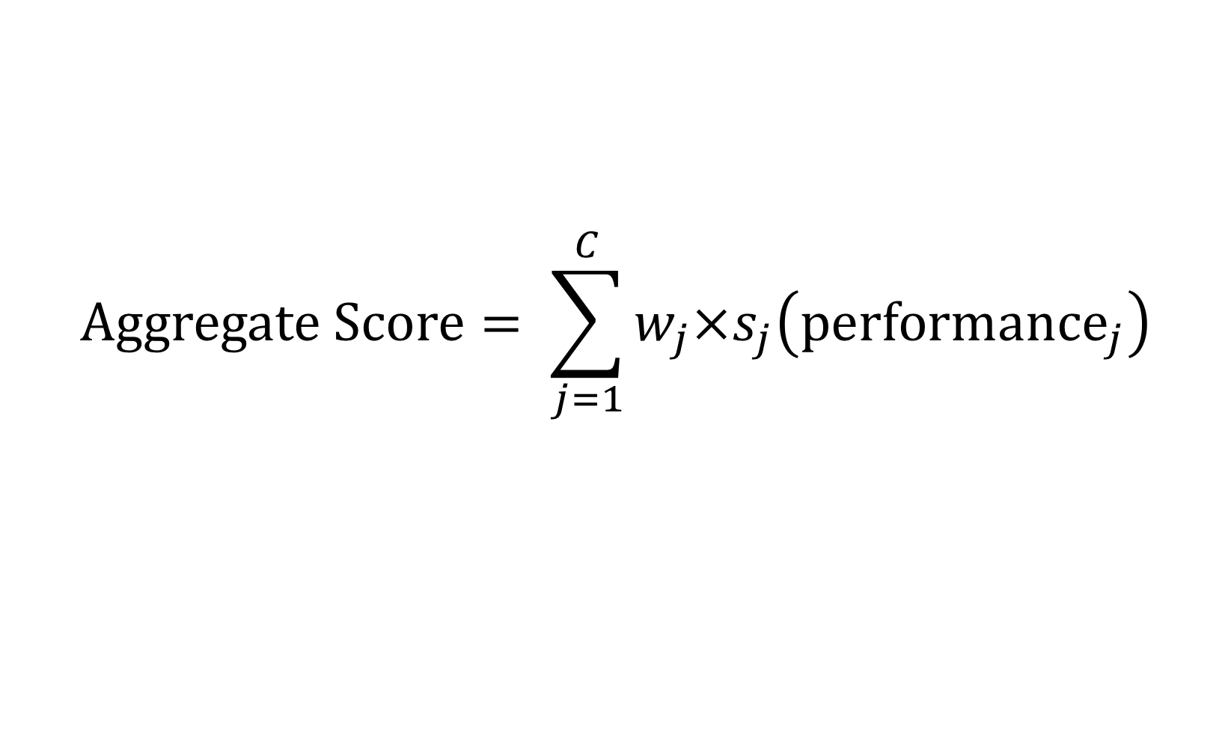
Step 6: Aggregate score
Scoring function
$$Aggregate Score= \sum_{j=1}^{C}{w_{j}{×s}_{j}\left(performance_{j}\right)}$$
Performance assessment
Weight

Slide 20
Accounting for uncertainty / variability
MCDA Step | Uncertainty evaluation
Performance measurement | Formal Bayesian modeling to fixed sensitivity analyses
Scoring function | Sensitivity analyses
Weighting criteria | Sensitivity analyses or distributions (SMAA; Tervonen et al, 2011)

Slide 21
Hypothetical application to case study
Safety endpoint 1
Safety endpoint 2
Efficacy
Performance Measures

Slide 22
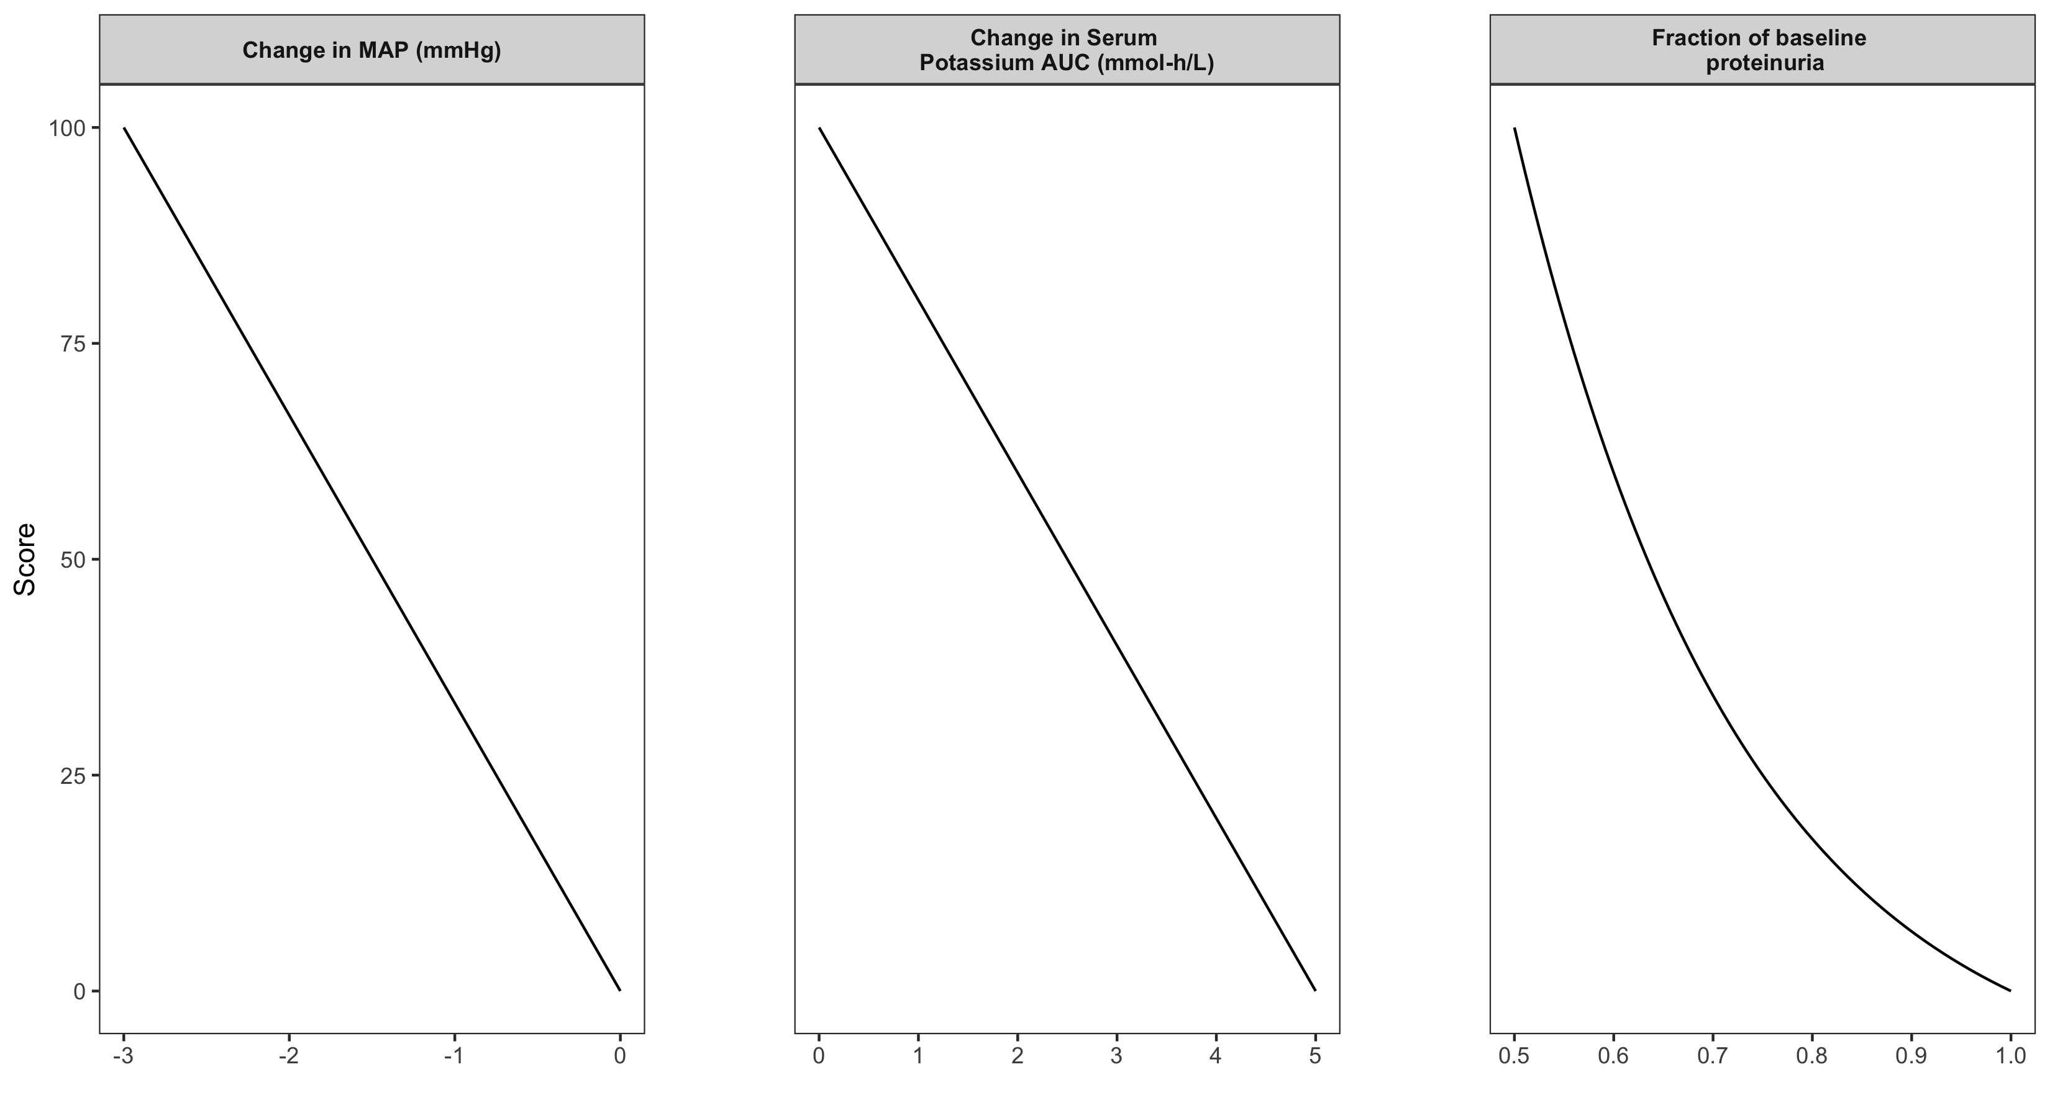
Hypothetical application to case study
Safety endpoint 2
Safety endpoint 1
Efficacy
Scoring Functions
Hypothetical scales for discussion only. Scales were not assessed for the actual analysis.

Slide 23
Hypothetical application to case study
Endpoint | Drug Developer | Regulator | A Specific Patient
Safety endpoint 1 | 0.40 | 0.55 | 0.33
Safety endpoint 2 | 0.20 | 0.10 | 0.33
Efficacy | 0.40 | 0.35 | 0.33
Weighting Functions
Hypothetical weights for discussion only. Weights were not assessed for the actual analysis.

Slide 24
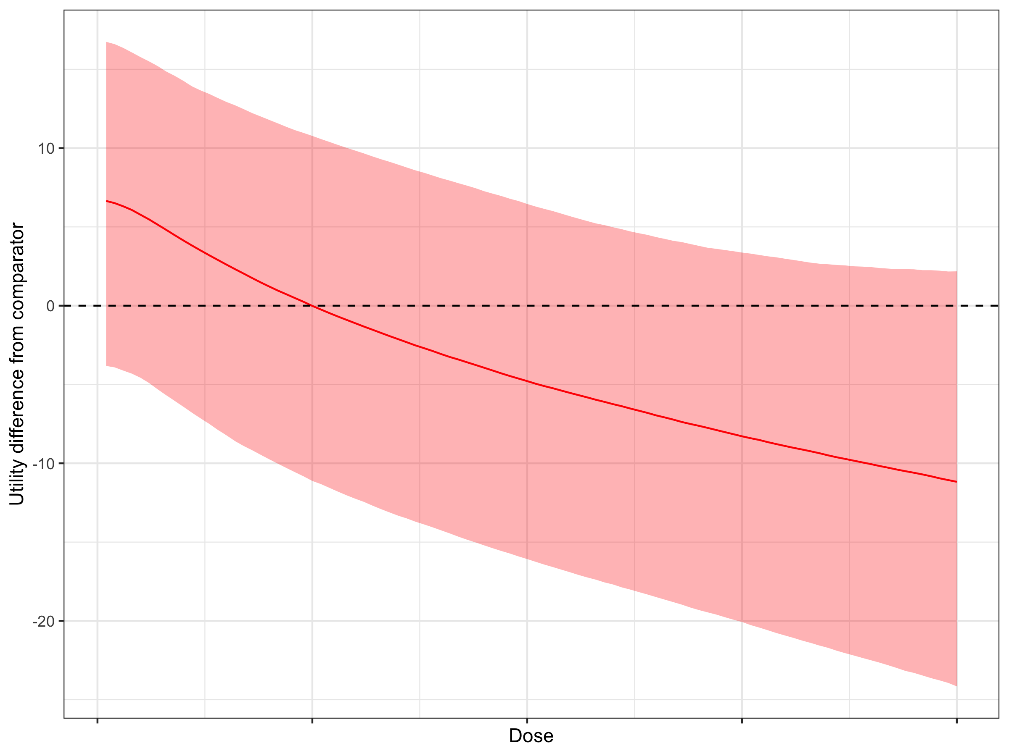
Difference in utility from comparator.
Median and 90% credible interval, using hypothetical Drug Developer weights.

Slide 25
Key points
Joint modeling
  allows modeling of correlations of safety and efficacy measures at the subject- and population levels
  Intuitive
Bayesian framework
  Enables ‘proper’ accounting for uncertainty in decision-making process
  Formal use of prior information – including formally updating benefit-risk assessment as the drug advances through development
MCDA
  Potentially useful approach to integrate efficacy and safety outcomes into a single measure
  Explicitly models different weights given to outcomes by different stakeholders

Slide 26
Acknowledgements
Eyas Abu-Raddad (Lilly-Chorus)
Marc Gastonguay
Arnab Mukherjee, Tim Nicholas
Other speakers in the session

Slide 27
References
Bellanti F, van Wijk RC, Danhof M, Della Pasqua O. Integration of PKPD relationships into benefit-risk analysis. Br J Clin Pharmacol. 2015 Nov;80(5):979–91.
Keeney RL, Raiffa H. Decisions with Multiple Objectives: Preferences and Value Trade-Offs. Cambridge University Press, Cambridge, UK, 1993.
Thokala P, et al. Multiple Criteria Decision Analysis for Health Care Decision Making—An Introduction: Report 1 of the ISPOR MCDA Emerging Good Practices Task Force. Value Health. 2016; 19: 1-13.
Tervonen, T., Van Valkenhoef, G., Buskens, E., Hillege, H. L., and Postmus, D. (2011). A stochastic multicriteria model for evidence-based decision making in drug benefit–risk analysis. Statistics in Medicine 30, 1419–1428. DOI: 10.1002/sim.4194

